Slide 1
New infrastructures for Big Data: NoSQL Databases

Slide 2
VOLUME and VELOCITY
A transaction represents the typical elementary unit of work of a Database Server
A transaction identifies a unit of work performed by an application
We also have VARIETY and VERACITY

Slide 3
Transactions
The classical DBMSs (also distributed) are transactional systems: they provide a mechanism for the definition and execution of transactions
In the execution of a transaction the ACID properties must be guaranteed
New DBMS have been proposed that are not transactional systems

Slide 4
ACID
Atomicity: A transaction is an indivisible unit of execution
Consistency: the execution of a transaction must not violate the integrity constraints defined on the database
Isolation: the execution of a transaction is not affected by the execution of other concurrent transactions
Persistence (Durability): The effects of a successful transaction must be permanent

Slide 5
NoSQL databases
It has been realized that it is not always necessary that a system for data management guarantees all transactional characteristics
The non-transactional DBMSs are commonly called NoSQL DBMSs
This really is not correct, because the fact that a system is relational (and uses the SQL language) and that it has transactional characteristics are independent

Slide 6
BIG DATA and the Cloud
DATA CLOUDS: ON DEMAND STORAGE SERVICES, reliable, offered on the Internet with easy access to a virtually infinite number of storage resources, computing and network
CLASSIFICATION OF POSSIBLE METHODS OF STORAGE:
Centralized or distributed, transactional, based on a traditional model (eg relational) remain the most widely used for traditional business applications (business information systems etc.).
Federated and multi-databases, generally for companies and organizations that are associated and share their data on the Internet
Cloud databases, to support BIG DATA by means of load sharing and data partitioning

Slide 7
NoSQL databases
Provide flexible schemas
The updates are performed asynchronously (no explicit support for concurrency)
Potential inconsistencies in the data must be solved directly by users
Scalability: no joins, ease of clustering, no 2PhaseCommit
Evolution to a “simpler” schema: key/value-based, semi/non-structured
Object-oriented friendly
Caching easier (often embedded)
Easily evolved to live replicas and node addition, made ​​possible by the simplicity of repartitioning of data
DO NOT support all the ACID properties

Slide 8
DATA MODEL
3/4 categories:
Key–Value
Document–based
Column–family
Graph-based
... Graphs not treated here, a separate evolutionary path from the other categories. They rely heavily on modeling relationships

Slide 9
Key -Value
Classical reference model of NoSQL systems
Key: single or compound
Value: blob, " opaque”
Querying = find by key
No schema (a dictionary)
Standard APIs: get / put / delete

Slide 10
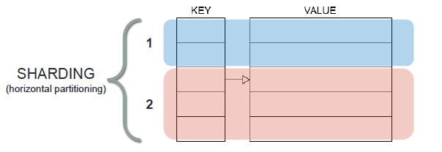
Key-Value: Scaling on multiple nodes
Joins limit scalability
No relationships in the database → easier to scale!
Decoupled and denormalized entities are ‘self-contained'
We can move them to different machines without having to worry about “neighborhood”!
Sharding (horizontal partitioning)

Slide 11
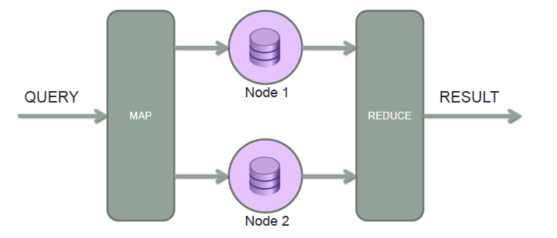
Map Reduce

Slide 12
Map-reduce paradigm
Apache Hadoop was the first high-impact proposal
Hadoop 1.0 only had HDFS and MapReduce
Hadoop 2.0 is more flexible
YARN, for resource description and management
Pig, Hive, Spark, Kafka (message broker), Sqoop (from DBMSs to Hadoop)
Apache Spark is currently receiving a lot of attention
MapReduce stores in mass memory intermediate results, with high costs when executing multiple steps
Spark manages a direct transfer from one step to the next, similar to pipelines in DBMS query plans
Several components. Among them:
MLlib (machine learning)
SparkSQL

Slide 13
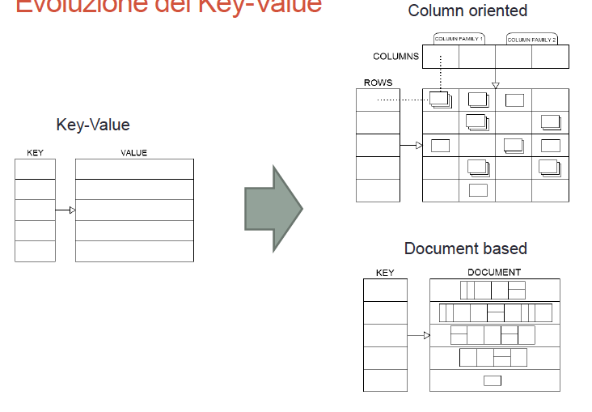
Further Models

Slide 14
Column -Family 1/2
Key is a triple row / column / timestamp
Value: "opaque”
Strongly oriented to Big Data, maximum scalability, the data is partitioned horizontally (sharding) and vertically (different columns on different machines) based on the keys of the row and column
Ability to query: get or filter only on row and column keys (indexed). Supports projection
Sorting is automatic, based on the names of rows and columns, so schema design is very important
Standard APIs: get / put / scan / delete

Slide 15
Column–Family 2/2
Semi-structured diagram:
Row: columns ​​indexed within each row by a row-key
Column-family: a set of columns, normally similar in structure to optimize compaction.
Columns in the same column family will be “close”: to be determined at design time. Equivalent to tables in the RDBMS, but are somehow “semi-structured” (empty column-families occupy 0 bytes)
Columns: have a name, indexed (column-key) and may contain a value (multi-version) for each row. Can be dynamically added (empty column occupies 0 bytes)

Slide 16
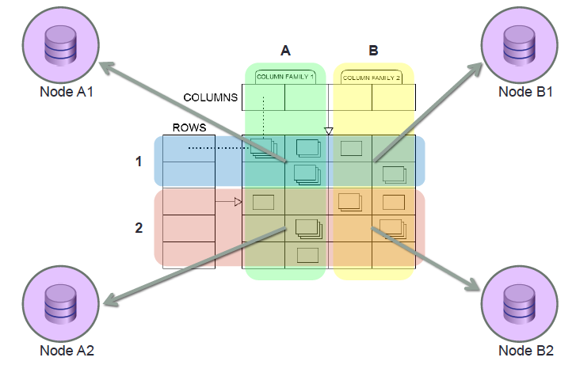
Column-family: maximum scaling
@Oscar Locatelli

Slide 17
Document-based
Key
Value: collection of documents whose structure is not fixed and not even comparable to XML or JSON, sometimes “nested”
Several mechanisms of the RDBMS, such as indexes, views, triggers, transactions (but very different in semantics)
Ability to query: rich filters (and also indexes) on the internal fields of the document
Schema-free and less ’sensitive' to design than a column- based
API: high–level, conceptual (like ORM)

Slide 18
The CAP theorem
A data management system shared over the network (cloud, networked shared-data system) can guarantee at most two of the following properties:
Consistency (C): all nodes see the same data at the same time
Availability (A): a guarantee that every request receives a response about whether it was successful or failed
(tolerance to) Partitions (P): the system continues to operate despite arbitrary message loss or failure of part of the system
According to Brewer's 2012 article, "2 of 3” is misleading:
because partitions are rare, there is little reason to forfeit C or A when the system is not partitioned.
the choice between C and A can occur many times within the same system at very fine granularity; not only can subsystems make different choices, but the choice can change according to the operation or even the specific data or user involved.
all three properties are more “fuzzy” than binary

Slide 19
The CAP theorem
In ACID, the C means that a transaction preserves all the database constraints
the C in CAP refers only to copy consistency, a strict subset of ACID consistency.
From this we can understand why in more traditional applications, such as banking or accounting, or bookings etc. these systems can be catastrophic
Interesting applications:
data collected from sensors (append-only)
In general, datasets that are seldom updated

Slide 20
SOME FAMOUS IMPLEMENTATIONS
Amazon DynamoDB
Key–value
CAP : AP - guarantees Availability and Partition tolerance, relaxing Consistency
auto – sharding
P2P networks
It aims to eliminate the job of the database administrator
Project Voldemort, SimpleDB
Google BigTable
Column-oriented, on the Google BigTable paper serves as the foundation to the NoSQL Column-based data –model
CAP: CP - if there is a network partition Availability is lost, but ‘strict' consistency may be required
auto-sharding, conflict resolution manual, no P2P

Slide 21
SOME FAMOUS IMPLEMENTATIONS (II)
Hypertable and Hbase
Implementations of BigTable (built on Google File System)
Both within Apache Hadoop (framework for distributed applications based on map-reduce)
Interface Thrift, REST and APIs for various languages
HBase extensible (coprocessors), Hypertable most powerful
Cassandra
Free from the Apache Foundation, Unix-like and Windows
Super-Column family
CAP : AP consistency with configurable auto - sharding, automatic conflict resolution
Combines the P2P with the data-model of BigTable
Transactions lock-free
Key names only on rows and columns
Also on Hadoop

Slide 22
SOME FAMOUS IMPLEMENTATIONS (III)
Redis
Originally developed by Salvatore Sanfilippo
Key-value model
Supports storage in mass-memory, but it operates in main memory
High performance and scalability, often used as a cache backend for Websites
Some limited support is offered for joins, but it has a big impact on performance, as it runs scripts on the server

Slide 23
SOME FAMOUS IMPLEMENTATIONS (IV)
MongoDB
Embeddable only in a C++ process, with LGPL license
Document–based
CAP: CP
auto-sharding with configurable strategy
static and automatic Indices created synchronously with the write
No transactions but atomic operations, and patterns for creating 2-phase commit or other policies
Query Task executed in Map-Reduce or otherwise distributed systems
In-place update of document attributes
Optimized for write-heavy (updates on index update and maintain consistency)
APIs for various languages ​​ORM-like
It is the most widely used and known of the document-oriented NoSQL systems, offers excellent performance and excellent documentation
But, it is not a DBMS

Slide 24
SOME FAMOUS IMPLEMENTATIONS (V)
CouchDB
Document model (internal format is JSON)
CAP: AP, Multi-Version Concurrency Control, strict consistency of master, slave where appropriate
View materialized on the first read and updated with map-reduce algorithm written in Javascript, projection, sort and calculations
Transactions lock free
Write-heavy, Read-heavy
CouchDB is also a WebServer, can do application hosting HTML5 + JavaScript that are treated as documents (then synchronized between multiple databases, easy load-balancing)
Couchbase, CouchDB offers Memcached + GeoIndex
CouchDB is the basis of the synchronization service Ubuntu One

Slide 25
Different products for different objectives
Enterprise Big Data: maximum performance and scalability: Amazon DynamoDB, Google BigTable and all their derivatives (Voldemort, Cassandra, HBase, Hypertable)
Document Management or RDBMS replacement (with extreme caution!!!): MongoDB (write heavy) RavenDB (read-heavy), BigCouch (both not discussed here)
Scenarios with online-offline, mobile devices/ laptops: CouchDB (Ubuntu One)

Slide 26
Other interesting solutions
CockroachDB
Emphasizes reliability, scalability and distribution
It is serverless
It uses Raft, an evolution of Paxos commit
Firebase
Developed by Google, well supported within GCP
It goes beyond classical DBMS tasks (it is presented as an app development platform: auth, log collection, …)
Firestore is now the NoSQL DBMS component
Supabase
Open source alternative to Firebase
It starts from PostgreSQL
It offers scalability (sharding) and sophisticated access control, adapting triggers to the management of expressive policy rules

Slide 27
Classification of data architectures
From «Deciphering data architectures», James Serra,O’Reilly, 2024

Slide 28
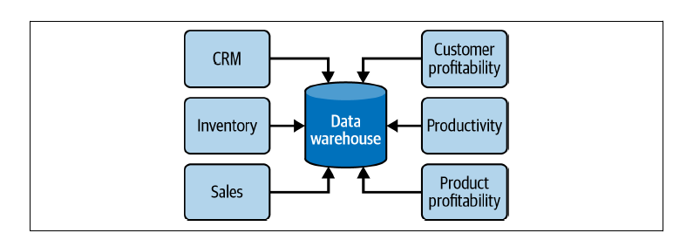
Data warehouse

Slide 29
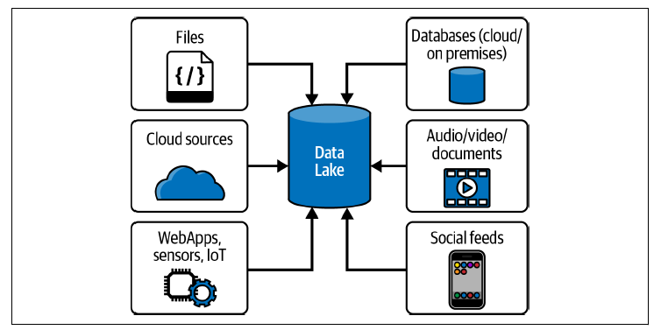
Data lake

Slide 30
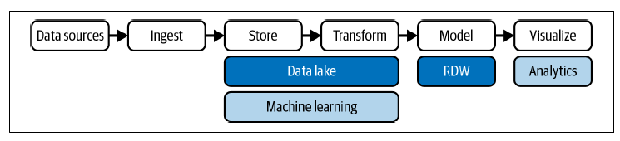
Modern Data Warehouse

Slide 31
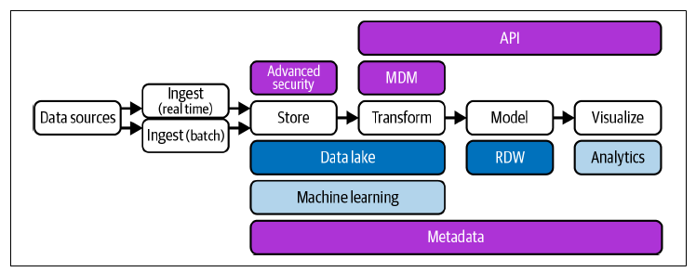
Data Fabric

Slide 32
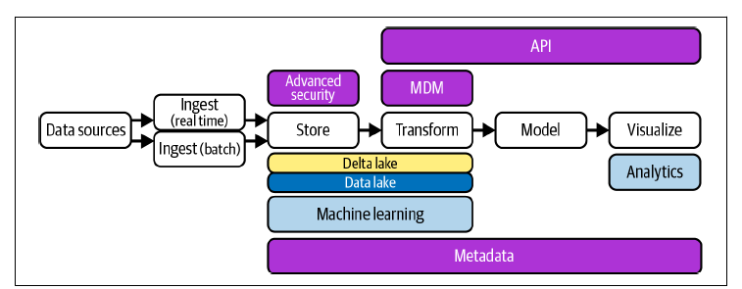
Data Lakehouse

Slide 33
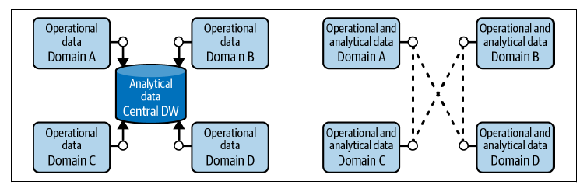
Data Mesh

Slide 34
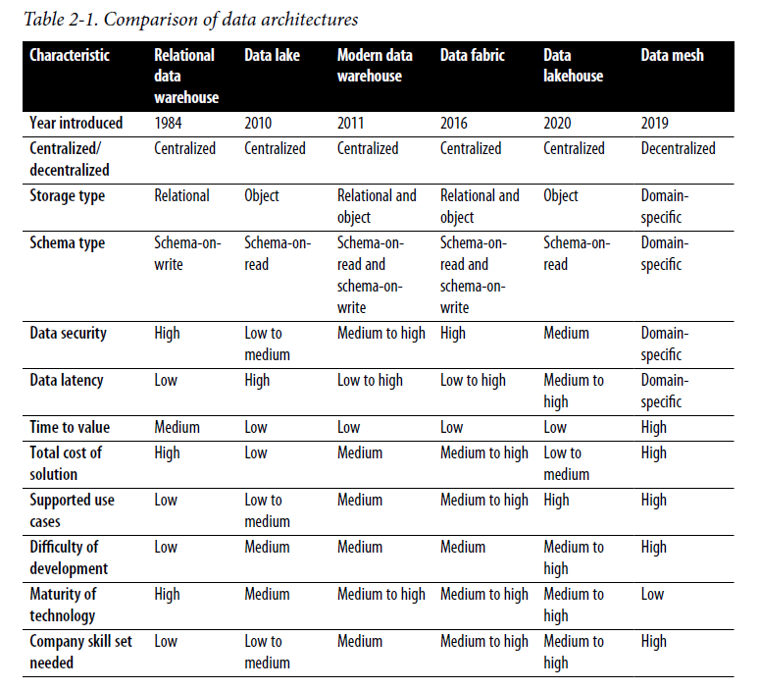
Classification of data architectures

Slide 35
A survey on DMS and DPS
A Model and Survey of Distributed Data-Intensive Systems
Alessandro Margara, Gianpaolo Cugola, Nicolò Felicioni, Stefano Cilloni, Politecnico di Milano
ACM Computing Surveys, June 2023
Open access at https://arxiv.org/pdf/2203.10836

Slide 36
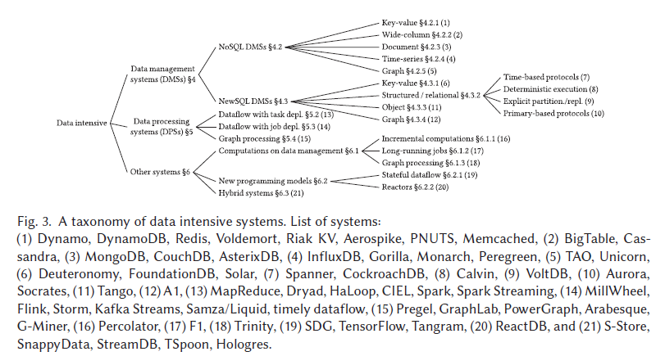
Taxonomy of data intensive systems

Slide 37
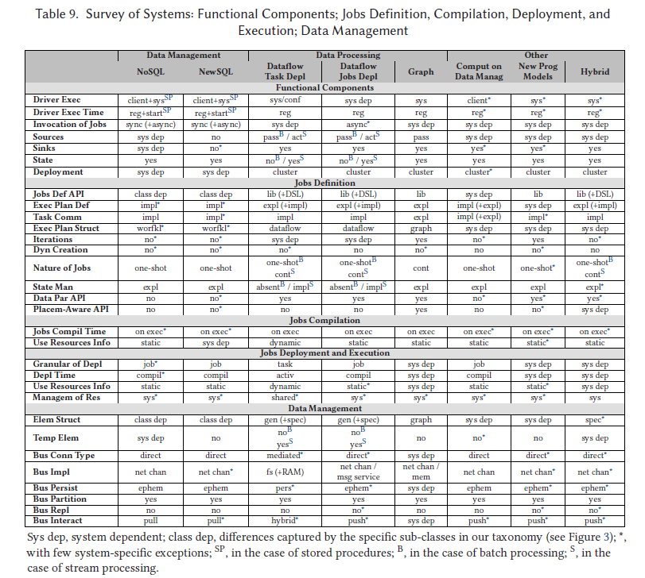

Slide 38
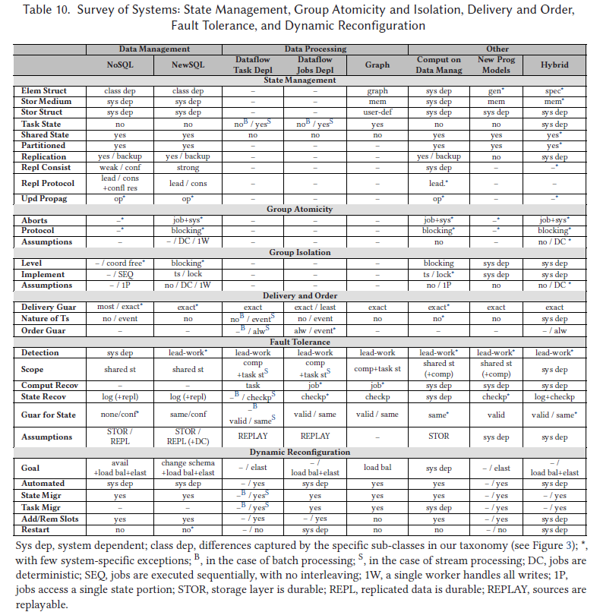

Slide 39
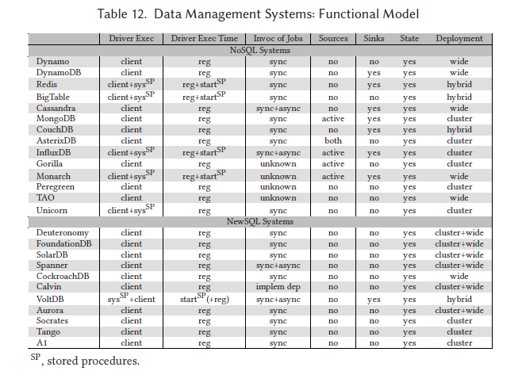

Slide 40
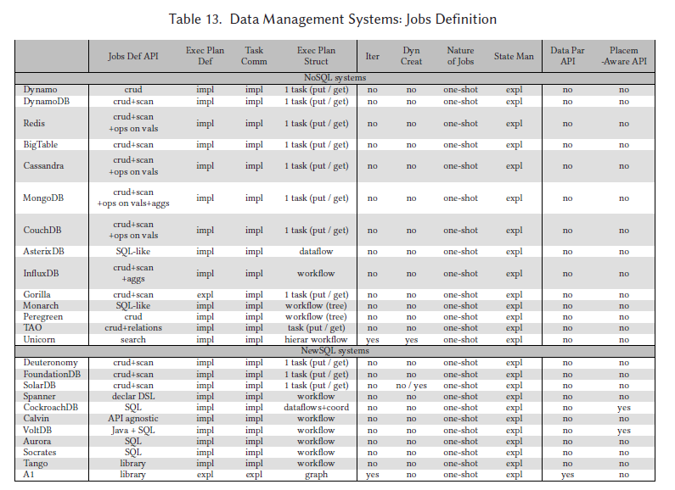

Slide 41
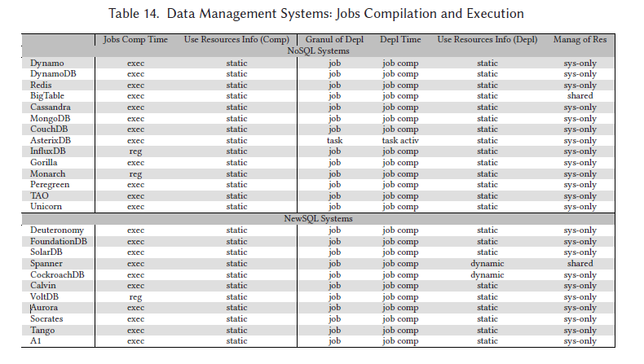

Slide 42
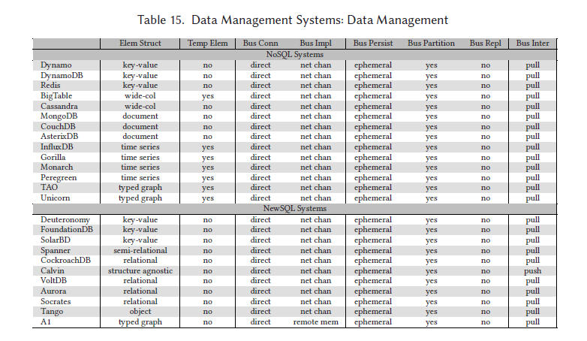

Slide 43
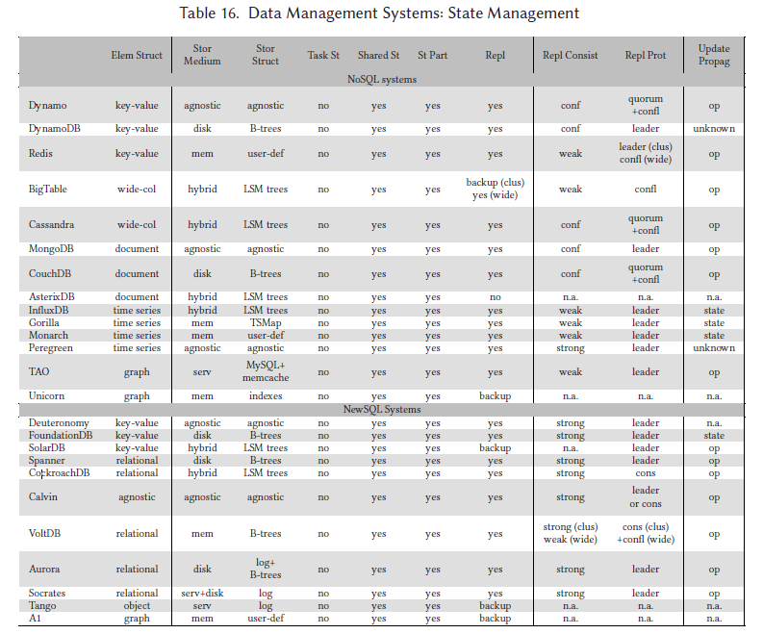

Slide 44
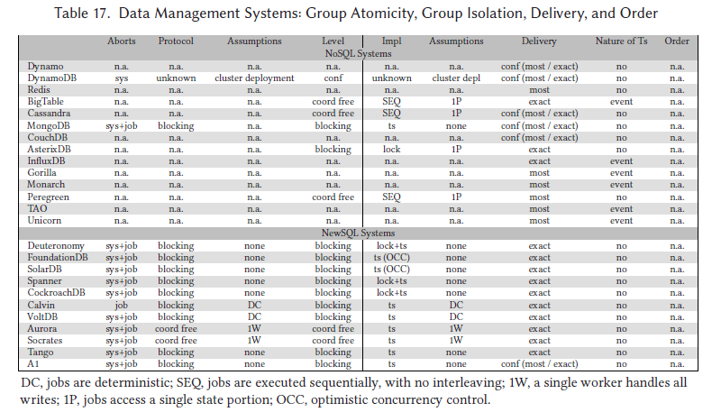

Slide 45
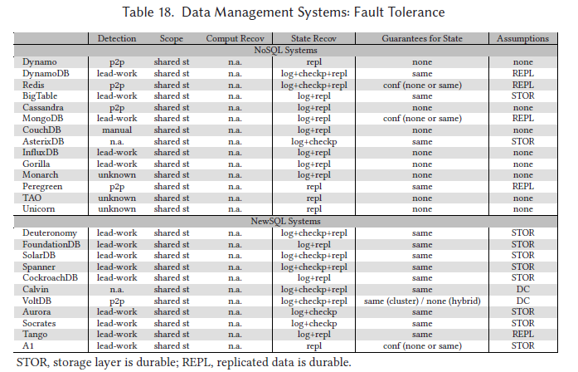

Slide 46
